Slide 1



Car Image Classification Using Convolutional Neural Networks
Team 13
Atulya Sharma (001306609)

Slide 2

Introduction
There are a lot of cars on the road and they continue to increase. Along with the number of cars the types of cars are also increasing. This project has been an attempt to classify cars using CNN and implementing parallelism to reduce the processing time.
Convolutional Neural Networks have been known to be efficient at doing image classification.
Parallel computing has shown that the use of multiple GPUs or CPUs result into better performance. We compare the speedup in this project.

Slide 3
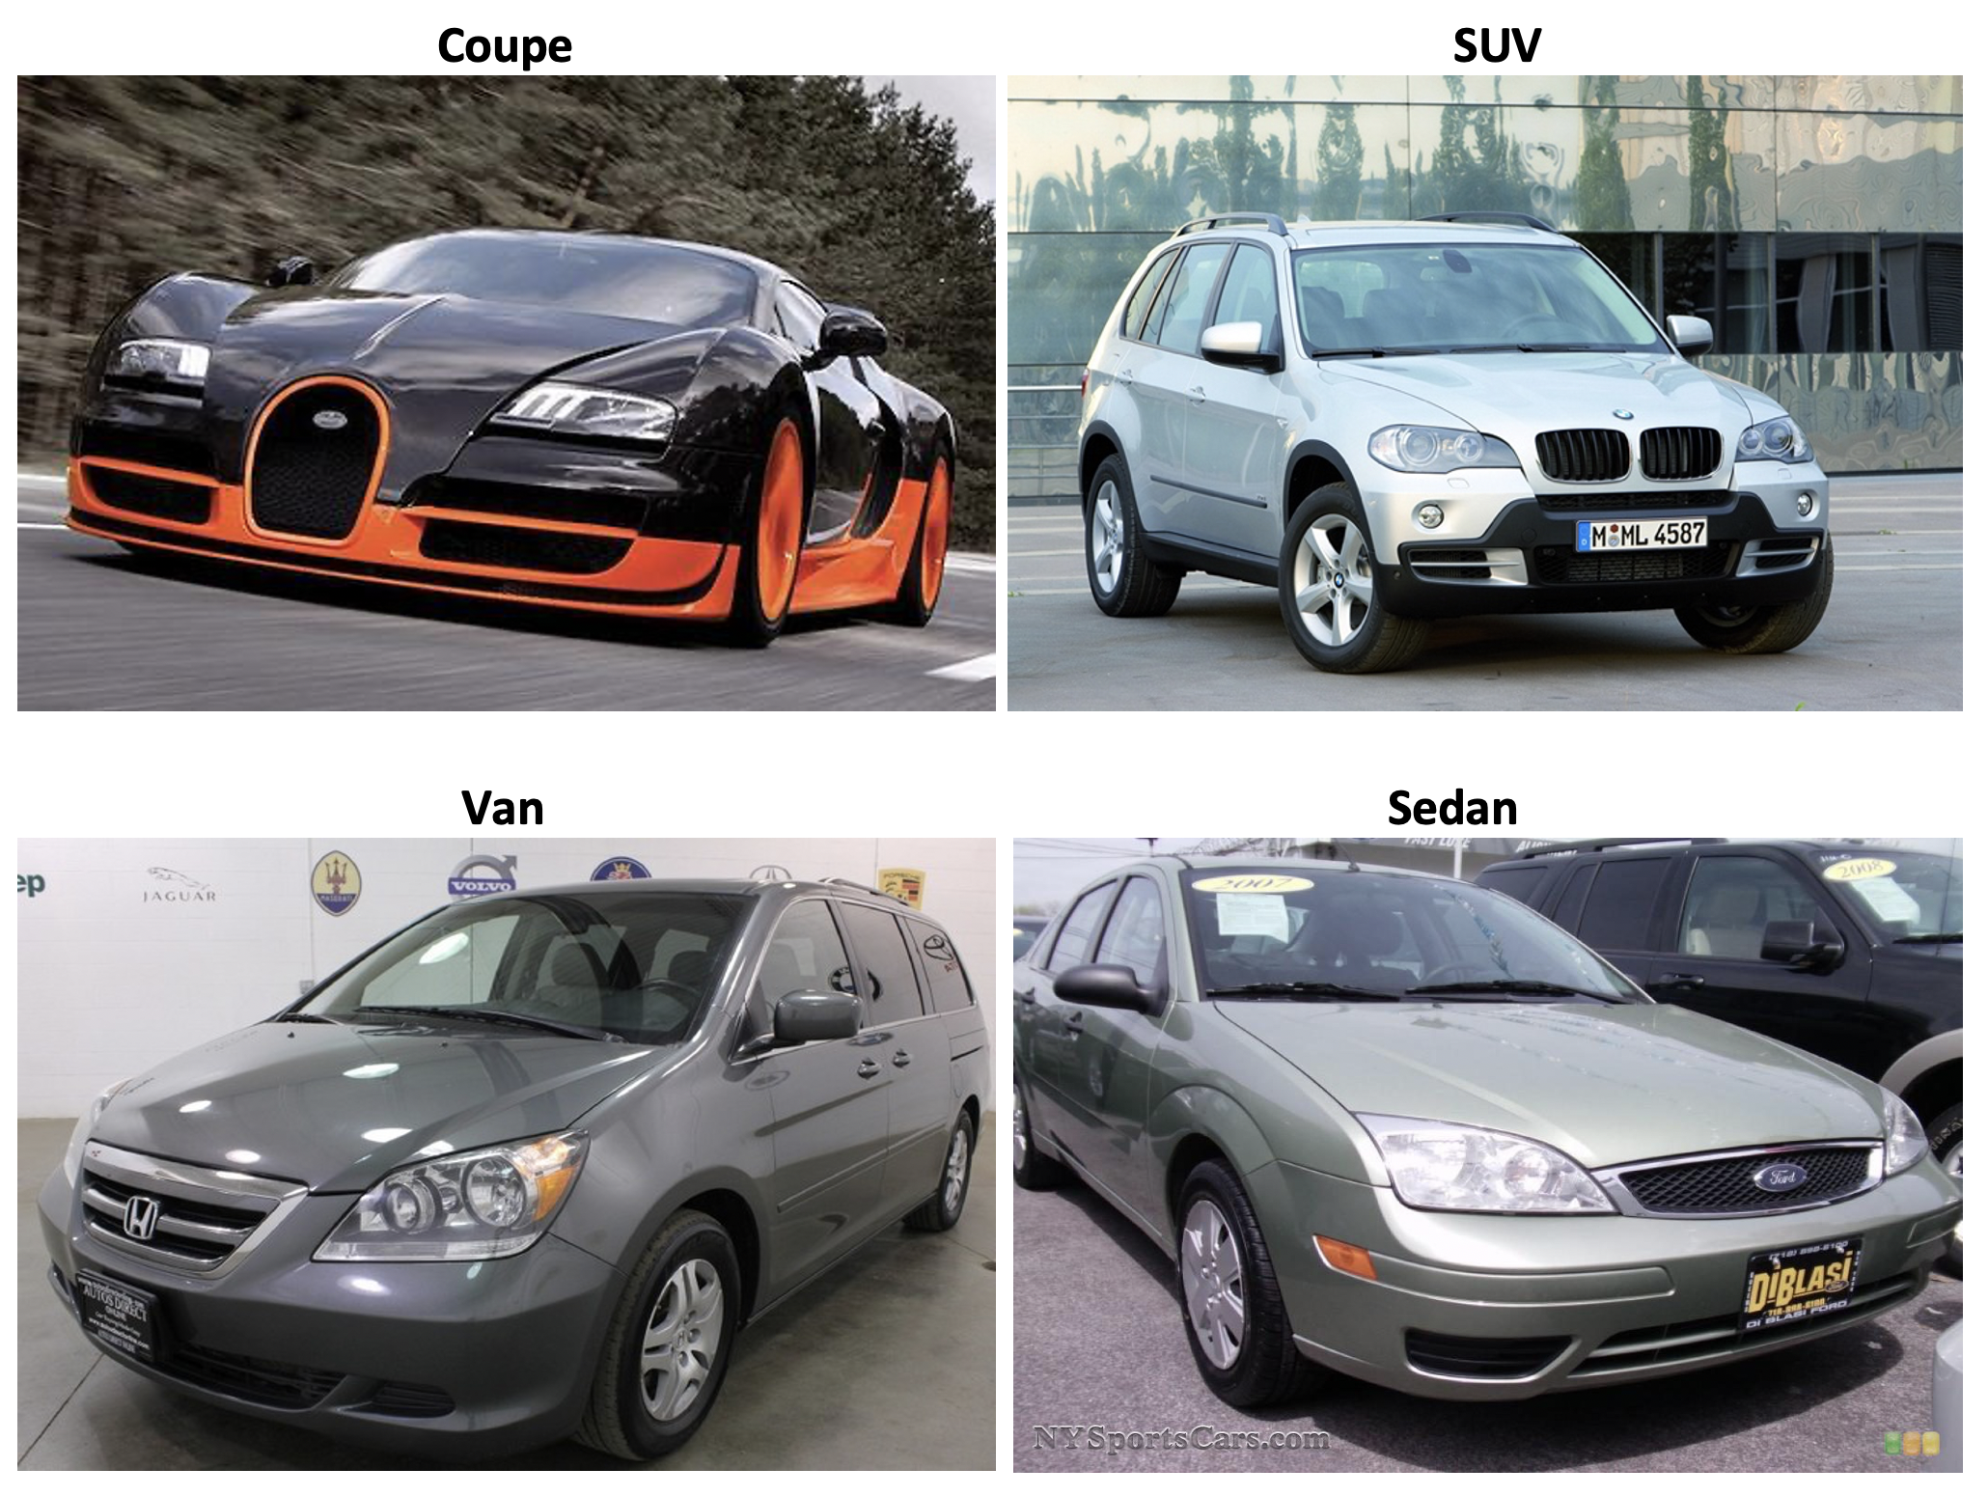
Introduction

Slide 4
Objectives
Primary objective is to run CNN with just one GPU followed by running it on 2 GPUs on Discovery Cluster.
In order to achieve this, we must create a virtual environment and then finally calculate the speedup.

Slide 5
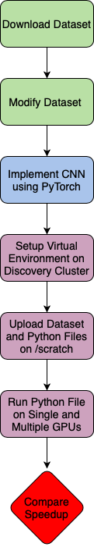
Flow Diagram

Slide 6
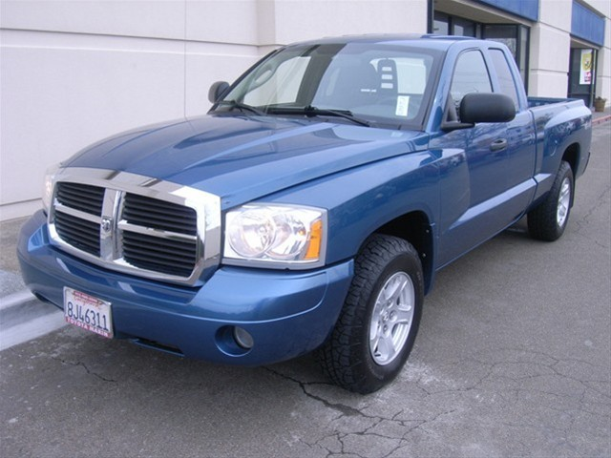
Dataset
Original Dataset had 196 classes of cars and total 16,185 images split roughly 50:50 into test and train.
Size of the dataset was 1.85 GB. The images were taken from different sides making it a complex dataset.
Dataset has been modified to total 9,163 images and converted into 8 subdirectories with 50:50 for test and train.
The Final dataset used had a size of approx. 1GB

Slide 7
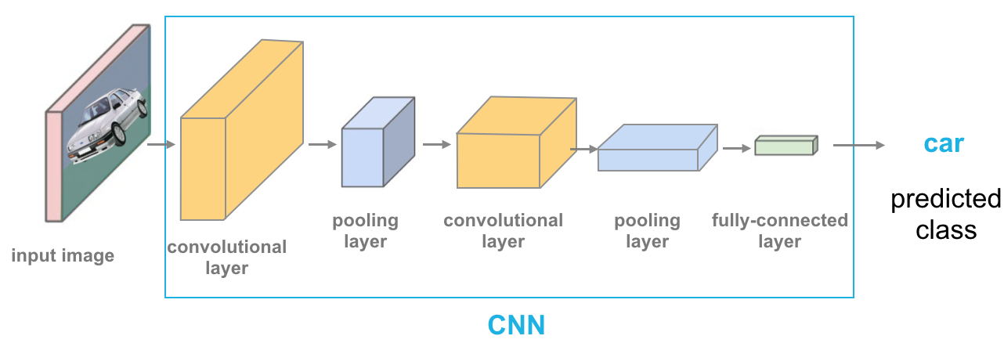
Convolutional Neural Networks
CNN is a class of Deep Neural Networks (DNN), most applied to analyze visual imagery like image classification and identification, video recognition, medical image analysis, Natural Language Processing, etc.

Slide 8
PyTorch
PyTorch is an open-source machine learning library based on the Torch library, used for applications such as computer vision and natural language processing, primarily developed by Facebook's AI Research lab. It is free and open-source software released under the Modified BSD license. In this project,
PyTorch has been used to run Convolutional Neural Networks to find the training and testing accuracy of the algorithm when asked to classify the images.

Slide 9
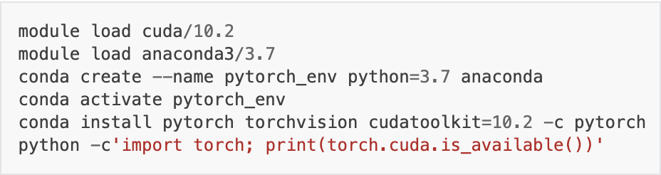
Discovery Cluster
srun -p reservation --reservation=csye7105-gpu --gres=gpu:1 --mem=16Gb --time=05:00:00 --export=ALL --pty /bin/bash
srun -p reservation --reservation=csye7105-gpu --gres=gpu:2 --mem=16Gb --time=05:00:00 --export=ALL --pty /bin/bash
HPC Cluster that uses Linux codes to operate
We need to be on a GPU node after logging in
In order to run the model on Multiple GPUS, we need to create a virtual environment which can run PyTorch in our case.
GPU used was Nvidia V100-SXM2

Slide 10
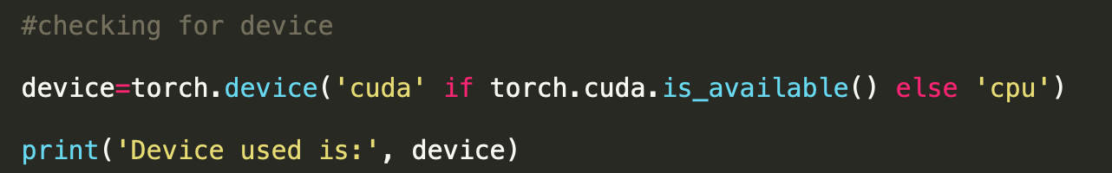

Code

Slide 11

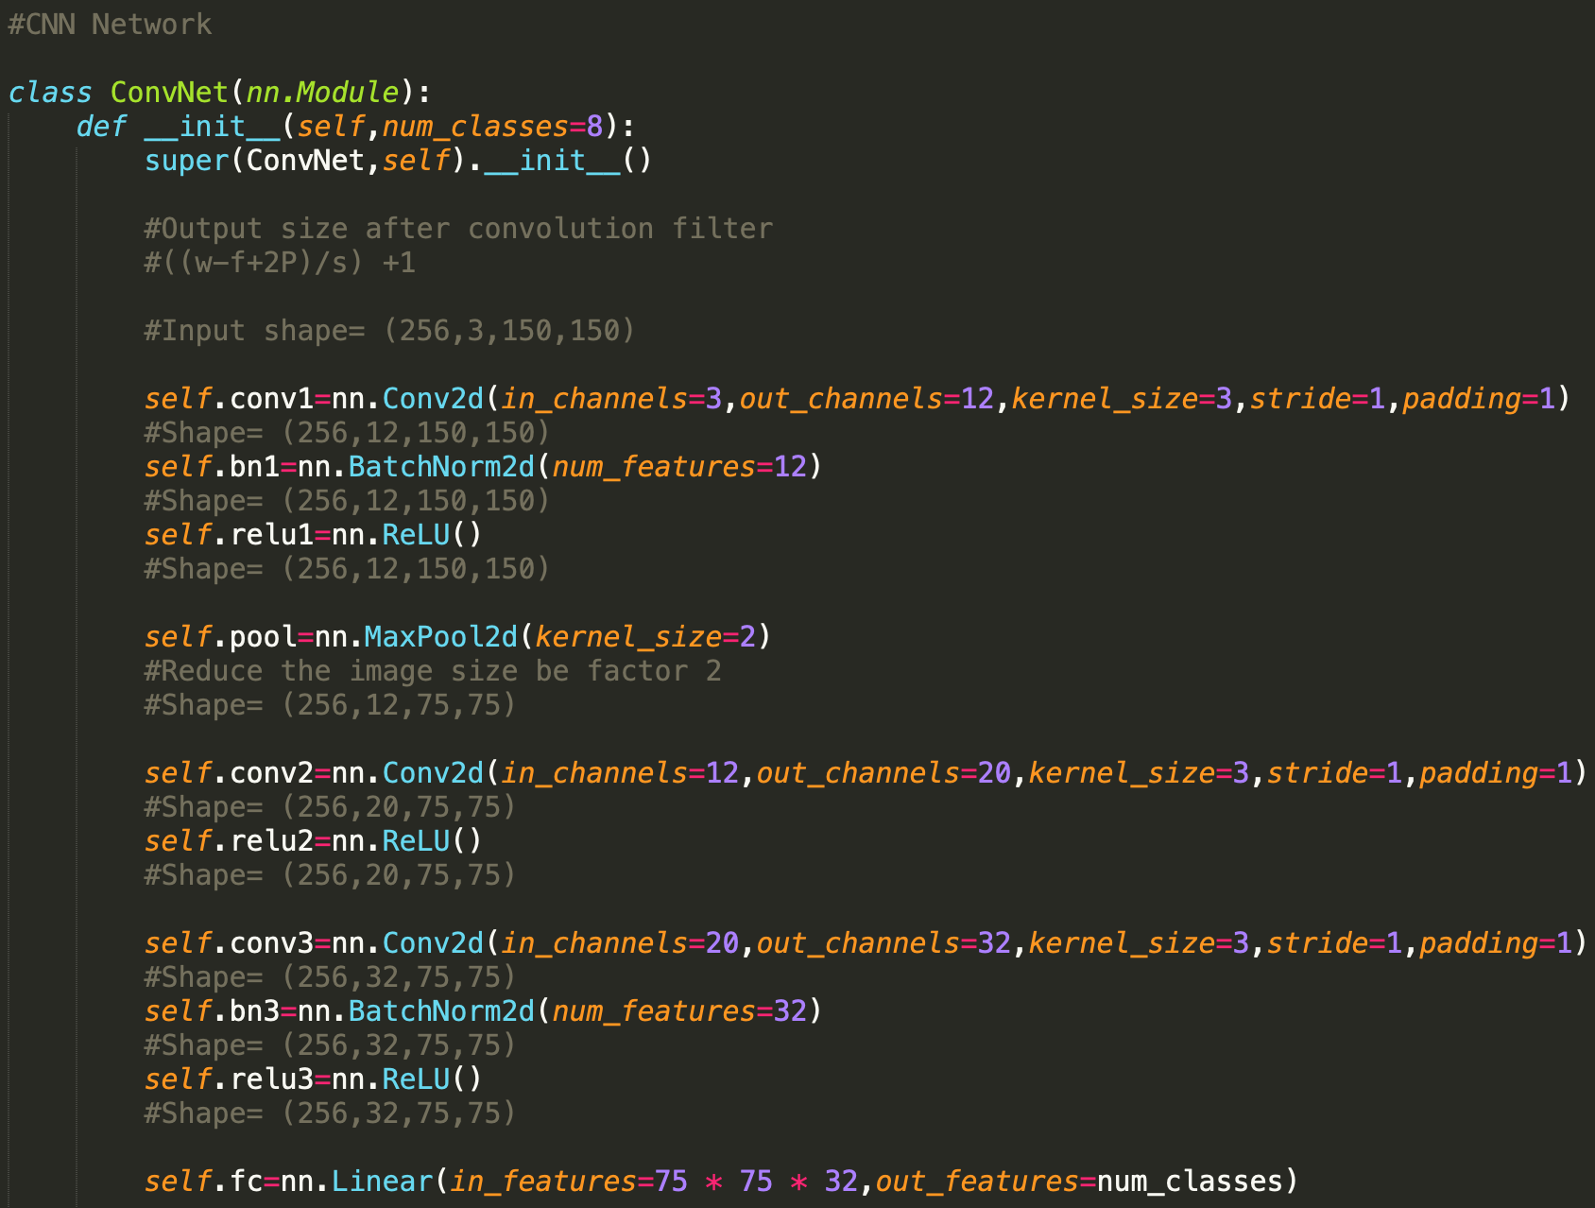
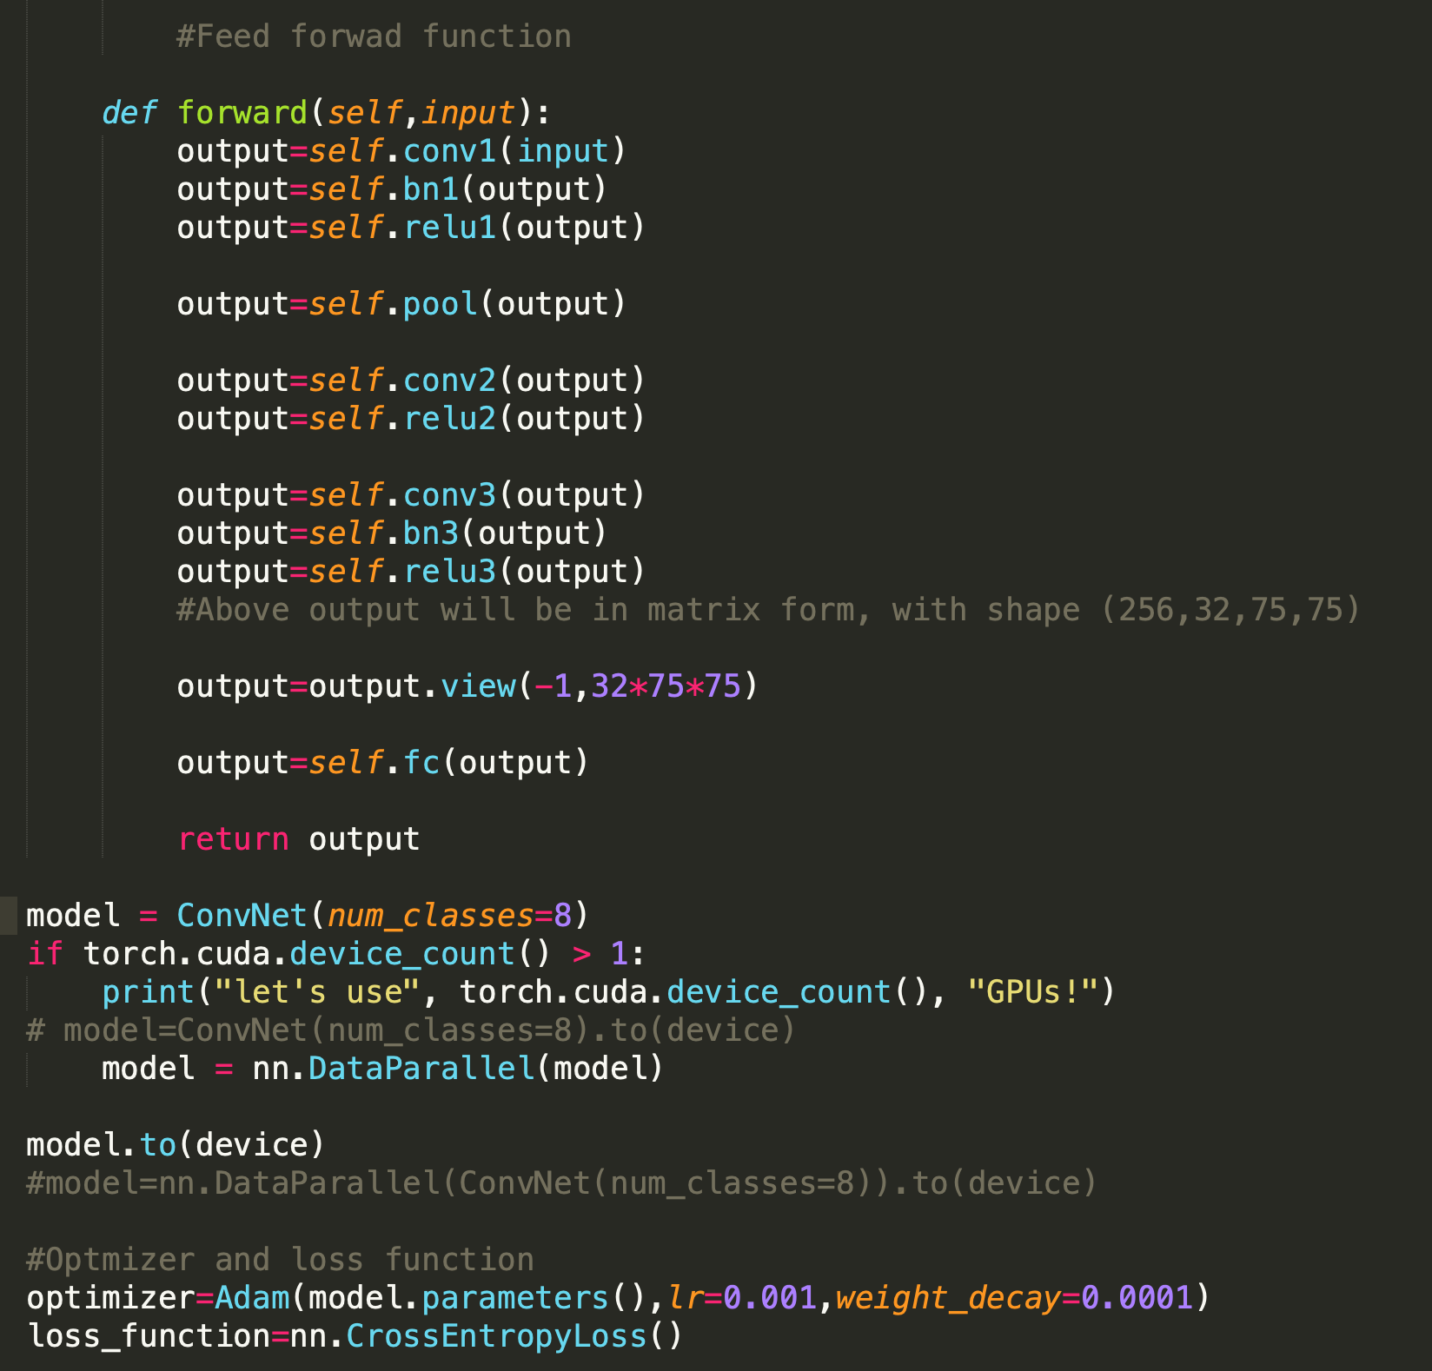
Implementing CNN

Slide 12

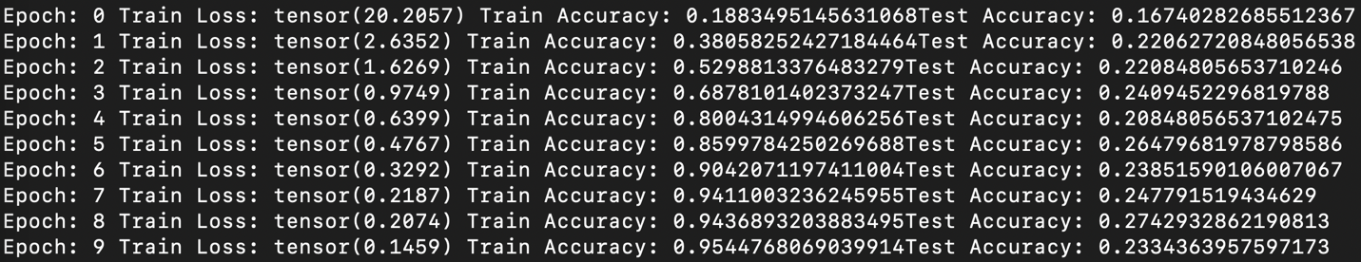

Serial Computing / Single GPU
For 10 epochs, following is the output for testing and training accuracy as well as

Slide 13
Serial Computing / Single GPU
The elapsed time when there is only a single GPU available is shown

Slide 14
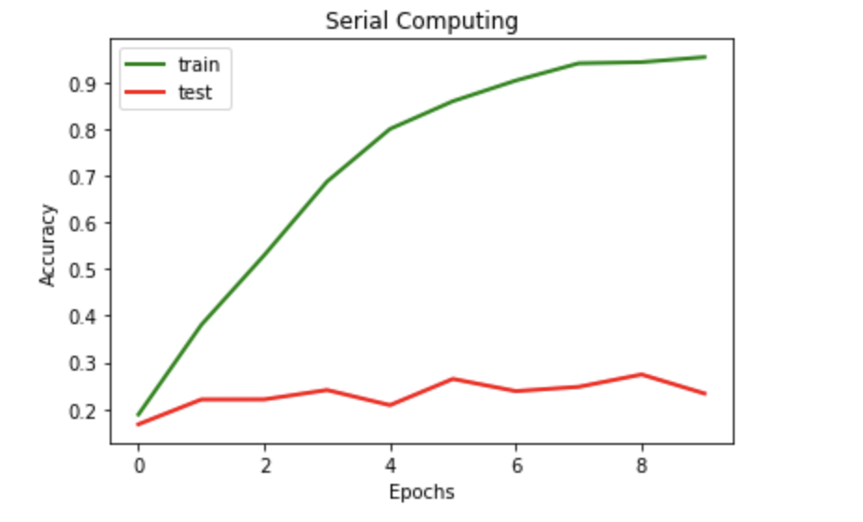
Accuracy V/S Epoch

Slide 15
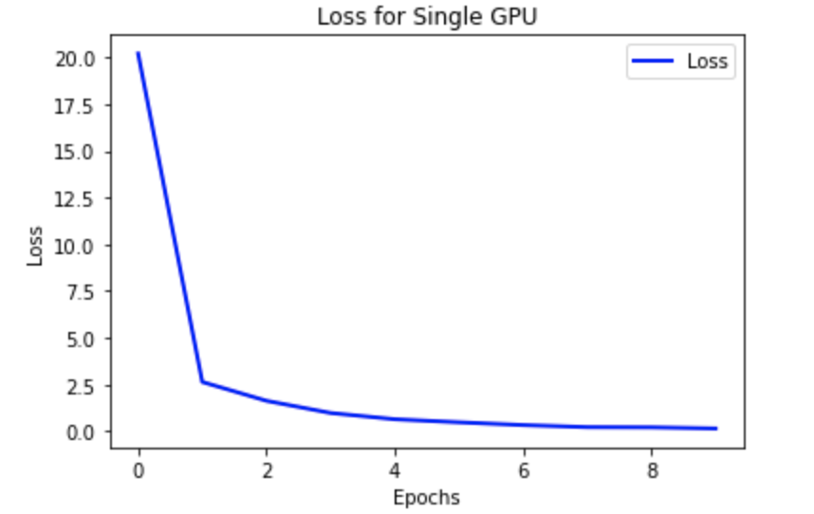
Loss for Single GPU

Slide 16
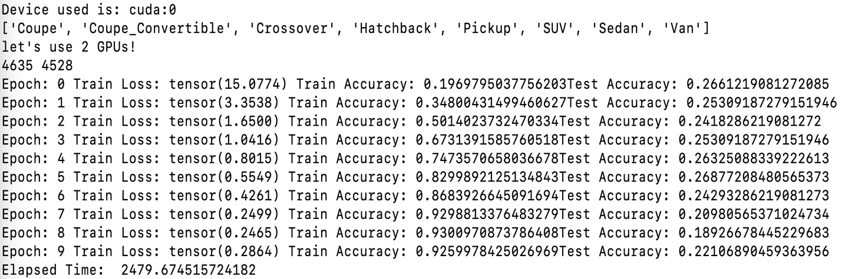
Parallel Computing / 2 GPUs
For 10 epochs, following is the output for testing and training accuracy as well as

Slide 17
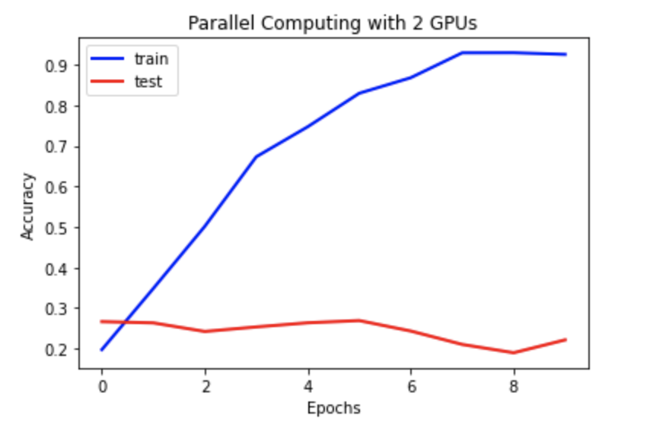
Accuracy V/S Epoch

Slide 18
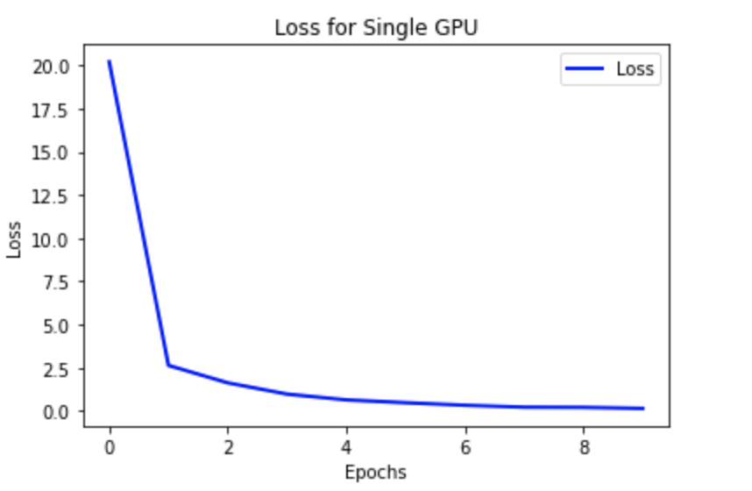
Loss for 2 GPUs

Slide 19
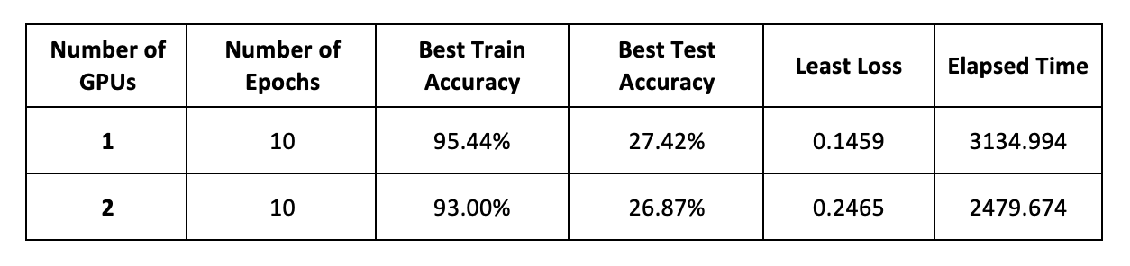
Result
The Speedup from Single GPU to 2 GPUs is 3134.994 / 2479.674 = 1.2642

Slide 20
Conclusion
Looking at the Speedup of 1.2642, parallel computing does hold a performance benefit over serial by reducing the time required to run complex tasks.

Slide 21
Dataset
http://ai.stanford.edu/~jkrause/cars/car_dataset.html

Slide 22

References
https://en.wikipedia.org/wiki/Convolutional_neural_network
https://en.wikipedia.org/wiki/PyTorch
https://rc-docs.northeastern.edu/en/latest/using-discovery/workingwithgpu.html

Slide 23
THANK YOU

